Slide 1
Quality Assessment and Communicating Student Learning
Part 5
Notes:
Welcome to part 5 of the Quality Assessment and communicating student learning series.

Slide 2
Included in Part 5
Assessment and Reporting for All
The Proficiency Scale
Insufficient Evidence (IE)
Notes:
Included in part 5

Slide 3
Fundamental Beliefs
If ….. we believe that it is important for all children and youth to
know they belong
See themselves as capable, strong, resilient, and connected individuals
Believe that with us, their ways of being, knowing and learning are welcomed, respected, and valued
Learn in an equitable educational setting that ensures that all students, regardless of their backgrounds or circumstances, have an equal opportunity to succeed academically and socially and reach their full potential
Then ….
every student has a place on the scale at any given time!

Slide 4
Educational Equity
"Every child, every day receives whatever she/he/they need to develop to her/his/their full academic and social potential and to thrive, every day. By “thrive,” I mean academically as well as social-emotionally. Every child has a right to feel loved and cared for and to feel that they belong to a community. Emotional well-being is as important as academic success in this definition of educational equity."
Elena Aguilar, "Coaching for Equity"
Notes:
We feel that it is important to further explore educational equity, and would like to share this definition provided by Elena Aguilar, Educational Coach and Author from her book "Coaching for Equity":
"Every child, every day receives whatever she/he/they need to develop to her/his/their full academic and social potential and to thrive, every day. By “thrive,” I mean academically as well as social-emotionally. Every child has a right to feel loved and cared for and to feel that they belong to a community. Emotional well-being is as important as academic success in this definition of educational equity."

Slide 5
When educators prioritize educational equity, it creates a fair and just academic environment for all students, providing them with the necessary opportunities and tools to succeed academically, socially, and ultimately, reach self-actualization.
Achieving educational equity requires a collective commitment from educators to break down systemic barriers that may prevent certain students from succeeding academically, regardless of their backgrounds or circumstances.
By focusing on educational equity, educators can ensure that every student has access to a quality education, regardless of their diverse identities, thus preparing them for a successful future both inside and outside the classroom.
Notes:
When educators prioritize educational equity, it creates a fair and just academic environment for all students, providing them with the necessary opportunities and tools to succeed academically, socially, and ultimately, reach self-actualization. Achieving educational equity requires a collective commitment from educators to break down systemic barriers that may prevent certain students from succeeding academically, regardless of their backgrounds or circumstances. By focusing on educational equity, educators can ensure that every student has access to a quality education, regardless of their diverse identities, thus preparing them for a successful future both inside and outside the classroom.

Slide 6
Assessment and Reporting for All
Inclusive education system in which all students, regardless of their identities, background, needs, abilities or circumstances, are fully participating members of a community of learners.
Students are entitled to equitable access to learning, resources, and the pursuit of excellence in all aspects of their educational programs.
Assessment and reporting practices must be inclusive of all students and reflect the histories, lived experiences, perspectives/worldviews, and cultures, and strengths.
Inclusive assessment practices allow students multiple opportunities to practice and demonstrate knowledge and competencies, which are assessed through observations, conversations, and multi-modal demonstrations of learning (Triangulating Evidence of Learning)
Notes:
Our inclusive education system prioritizes the participation of all students, regardless of their identities, backgrounds, needs, abilities, or circumstances. This means that every student should have equitable access to learning, resources, and the pursuit of excellence in all aspects of their educational programs. Assessment and reporting practices are critical components of an inclusive education system, as they play a vital role in reflecting the histories, lived experiences, perspectives, worldviews, cultures, and strengths of all students. Inclusive assessment practices allow students multiple opportunities to practice and demonstrate knowledge and competencies. These assessments are conducted through observations, conversations, and multi-modal demonstrations of learning, which are known as triangulating evidence of learning.

Slide 7
Equitable & Decolonized Assessment Practices
Including students in the assessment process and co-constructing assessment criteria provides an opportunity for students to consider ways to incorporate their heritage, community cultural practices, and fluencies in any evidence of learning. It is through the following that educators can foster the holistic development of the whole person and honour students diverse identities, experiences and abilities within their teaching and assessment practices. Thereby create a more equitable and just learning community.
Culturally Responsive Assessment
Authentic Assessment
Multiple Modes of Assessment
Collaborative Assessment
Flexible Assessment
Decolonized Assessment
Transparent Assessment
Reflexive Assessment
Diverse Representation
Continuous Improvement
Notes:
Including students in the assessment process and co-constructing assessment criteria provides an opportunity for students to consider ways to incorporate their heritage, community cultural practices, and fluencies in any evidence of learning. It is through the following that educators can foster the holistic development of the whole person and honour students diverse identities, experiences and abilities within their teaching and assessment practices. Thereby create a more equitable and just learning community.

Slide 8
PAUSE
Refer to the Equitable and Decolonized Assessment resource and engage in the following:
Self-Reflection
Which practice are you most interested in exploring further and incorporating into your assessment practices?
Table Talk
In what ways do you see these practices impacting the students in your school community?
Which ones could be a focus in your school's context?
Notes:
Please Pause the video at this time and engage in table talk discussions with the following question.

Slide 9
Learning is Continuous
Averaging marks over a term, semester, or year does not provide an accurate picture of student learning. Learning is continuous. Therefore, learning demonstrated close to the communication of student learning will be the most reflective of student proficiency and should be used as the strongest evidence of learning when deciding on a proficiency scale indicator or letter grade and percentage.
Notes:
One of the components of standards based assessment is honouring that learning is continuous. Averaging marks over a term, semester, or year may seem like an easy way to assess student progress, but it does not necessarily provide an accurate picture of a student's learning. Student progress can fluctuate throughout the year. That's why it's important to consider the learning demonstrated closest to the time of communication of student learning. This will give a more accurate reflection of a student's proficiency and should be used as the strongest evidence of learning when deciding on a proficiency scale indicator or letter grade and percentage. By focusing on the most recent evidence of a student's learning, educators can ensure that they have an accurate understanding of each student's progress and can provide appropriate support and guidance to help them continue to grow and succeed.

Slide 10
Benefits of using the proficiency scale for assessment
Clearly identified learning standards/goals- an explicit description of what a learner should Know, Understand, and be able to Do as a result of learning
Clearly identified success criteria in relation to the learning standard/goal
Is flexible, adaptable and inclusive of all students and supports personalized learning
Learning is ongoing and descriptive feedback is provided to guide growth and improvement
Supports lifelong learning by shifting the focus from marks to learning which increases motivation and engagement and develops independence and self-efficacy
Notes:
The proficiency scale supports the continous development of learning standards because it includes the learning progression for that standard/goal, rather than just evaluating the performance on one-time test, exam, assignment, or task. There are several reasons why using the proficiency scale can be positive for student learning:
Clear learning expectations: Proficiency scales clearly outline the specific skills or knowledge areas that students are expected to demonstrate, providing clear learning expectations. This allows students to have a better understanding of what they need to learn, practice and develop, which can help them set goals, focus their efforts, and monitor their progress.
Personalized learning: using the Proficiency scale allows students to progress at their own pace and demonstrate the skills or knowledge of the learning standard/goal when they are ready. This personalized approach to learning helps students to take ownership of their learning process.
Flexibility and adaptability: Learning using the Proficiency scale as a guide allows for flexibility and adaptability in the assessment process. Students can progress at their own pace, and teachers can provide additional support or challenge based on individual needs. This flexibility accommodates different learning styles, abilities, and interests, making the assessment process more inclusive and effective for diverse learners.
Teachers provide feedback that is focused on specific skills or knowledge areas, which allows students to identify their strengths and next steps This feedback can guide students in improving their performance in areas where they may be struggling, helping them to make targeted efforts to enhance their learning. This also helps teachers identify their next steps based on how their students are doing.
Having students identify their strengths, and next steps leads to increased motivation and engagement for students because they are already achieving a certain level of success as they see their progress and growth over time.

Slide 11
Every student has a place on the scale
Every student comes into each learning situation with their own histories, lived experiences, background knowledge, assets, skills, fluencies, and interests.
Each student has their own entry point into the proficiency scale.
Each proficiency level has value, and clearly defined criteria. It is not a deficit if students are entering at the Emerging or Developing level. This just defines the specific criteria that they are learning, practicing and developing for that learning standard/goal. Our goal is to support students to work their way towards proficiency by developing the criteria based on what level they are on the scale and demonstrating growth over time.
Not all students necessarily begin at the Emerging or Developing levels, some may already be Proficient and thus being challenged at the Extending level.
Students' progress at different paces. Some students may not achieve Proficiency by the end of the year. It is however important to identify and acknowledge the learning and growth that has occurred during the course/term/year
Students may reach Proficiency at any point during the course/term/year depending on their individual progress; if a student enters a learning experience as Proficient or achieves proficiency during the school year, the goal becomes to further enhance their learning and have them focus on the Extending criteria.
Notes:
Every student brings their own unique histories, experiences, background knowledge, assets, skills, and interests to each learning situation. With this, each student has their own entry into the proficiency scale. As a result, it is not always accurate to assume that a student will begin at the Emerging or Developing level at the beginning of the school year. Some students may already have a solid foundation of knowledge and skills in certain areas, allowing them to start at the Proficient level or higher. Similarly, it's important to understand that not all students will reach the Proficient level by the end of the school year. Learning is a continuous process, and progress can be influenced by a variety of factors, including personal circumstances and opportunities for practice and feedback.
It's also essential to recognize that achieving Proficient is not the end of learning. Even if a student enters a learning experience with a Proficient understanding or achieves Proficient during the school year the goal then becomes to further enhance their learning and have them focus on the Extending criteria .

Slide 12
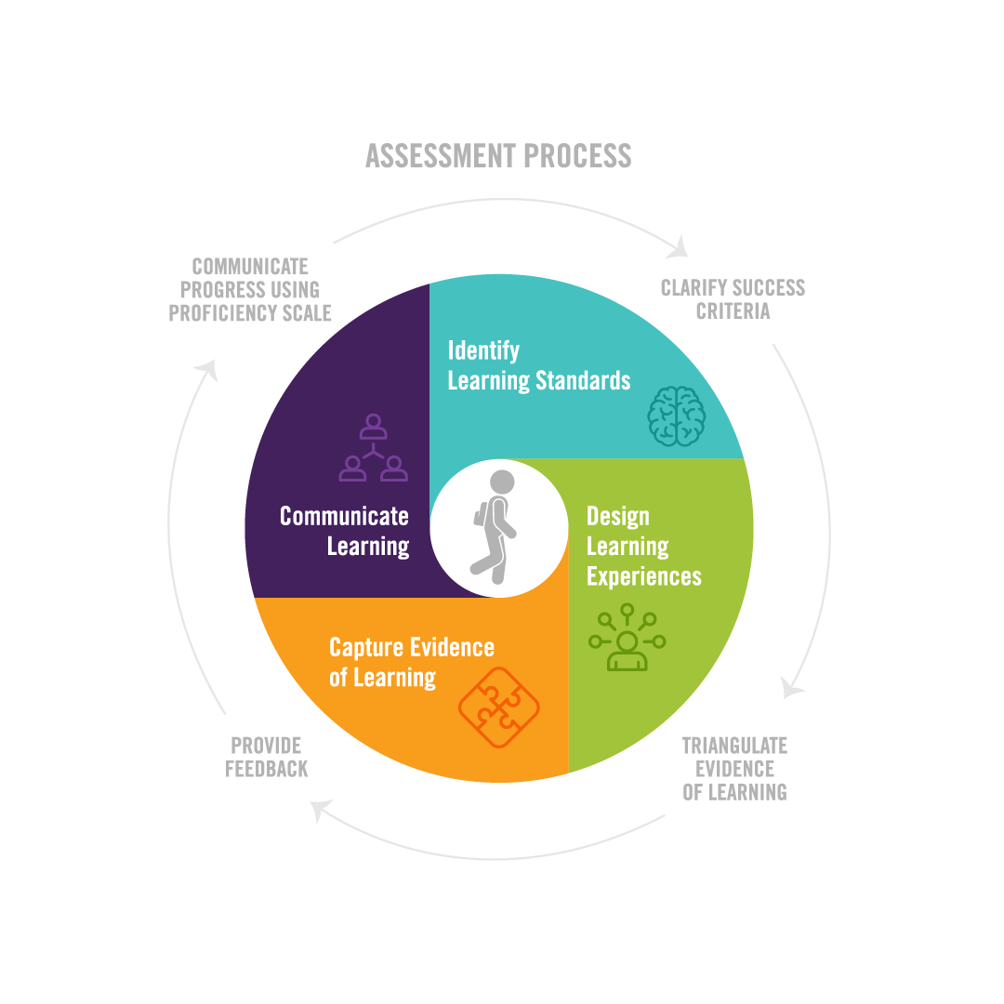
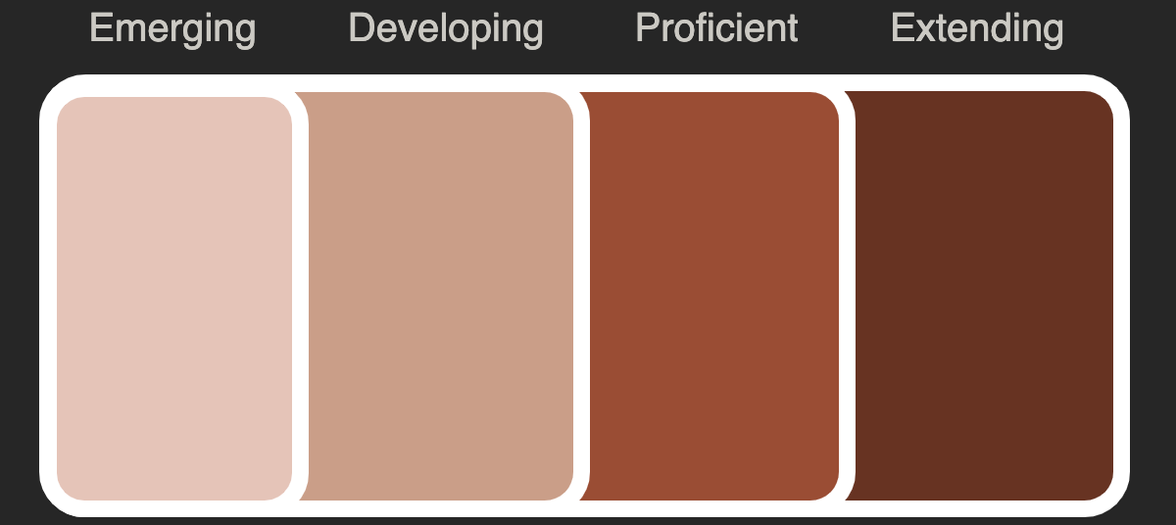
/CREATE PROFICIENCY SCALES
& REPORTING
Notes:
We know that the learning standards come from the content standards and curricular competency standards in our curriculum (Know, Understand, Do)
Once we have the learning standard or goal we need to clarify success criteria for proficiency and build out the learning progression for that learning standard/goal
That progression helps clarify the different levels on the proficiency scale and is used for growth and development of skills and knowledge in that learning standard/goal

Slide 13
Unpacking the Proficiency Scale
Emerging
Developing
Proficient
Extending
Notes:
The Provincial Proficiency Scale is used to communicate student learning in all areas of learning. It is a requirement for student reporting in Grades K-9. The four points on the scale are Emerging, Developing, Proficient, and Extending.
Each point on the scale corresponds to a level of skill development and content knowledge and is used to evaluate a student's progress in meeting the learning standards set out in the B.C. curriculum. The scale is designed to provide a clear and consistent way of communicating student learning to parents, educators, and students themselves. The Proficiency Scale provides a valuable tool for tracking student progress over time and identifying areas where additional support or resources may be needed.

Slide 14
Unpacking the Proficiency Scale
Emerging
Developing
Proficient
Extending
Student demonstrates an
initial
understanding of
the concepts and
competencies relevant
to the expected learning.
Student demonstrates
a
partial
understanding of the concepts and
competencies relevant to the expected learning.
Student demonstrates a
complete
understanding of the concepts and competencies relevant to the expected learning.
Student demonstrates a
sophisticated
understanding of the concepts and competencies relevant to the expected learning.
Notes:
The ministry has provided the following descriptions for the proficiency indicators. These can be vague on their own, and offer little information to students, parents and caregivers on the student's progress in relation to the learning standards. The terms Initial, partial, complete, and sophisticated are in relation to the success criteria, skills/competencies, and content knowledge of each learning standard/goal, thus we as teachers need to develop and define the proficiency scales for each so that the learning progression is transparent to us and to our students.

Slide 15
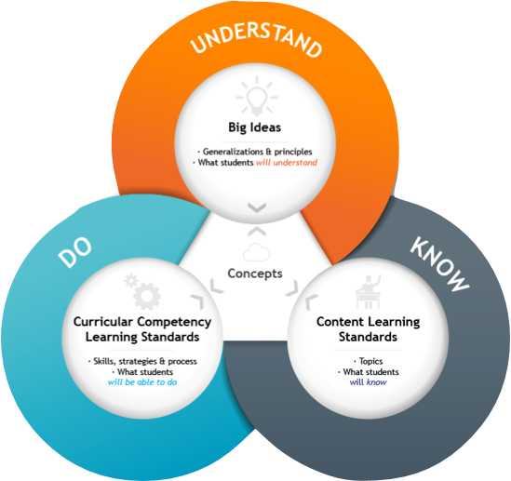
PROFICIENCY – What students know and what they can do
LEARNING STANDARD/GOAL
EMERGING
EMERGING
EMERGING
DEVELOPING
PROFICIENT
EXTENDING
Progressive & Additive
Positive​
Descriptive​
Notes:
Once we have identified the learning standard/goal that we are focusing on, we need to unpack what students should know and be able to do. The different levels of proficiency are not stand alone, instead the skills and content knowledge build upon one another. Although proficiency scales are illustrated as linear, we found this model of the scale and accompanying concepts designed by Numeracy Helping Teachers Marc Garneau and Chris Hunter, helpful in making meaning of the proficiency scale.
The proficiency scale is progressive and additive, which emphasize the concept of expanding and growing. As students move through the different levels of proficiency, they maintain the skills and content knowledge from previous levels, while developing and enhancing new skills and deeper level of content knowledge. So in other words, the skills and content knowledge that is developed in the emerging column is built upon in the developing column, with new skills and knowledge added, and then those are built upon in the proficient column with new skills and knowledge, and so on.
Proficiency scales are also Positive. When we are building out the scale, we consider the learning progression for the Learning standard. We start with the success criteria in proficient. The emerging and developing are not deficits of the proficient column, they are the building blocks of the proficient criteria, therefore it is important to be Descriptive and outline what students know and can do in each level of the scale.
Some times, proficiency scales and or rubrics are designed by articulating the success criteria in the proficient column, and then words such as support, some, and seldom are added to give the impression of differentiation between levels. However, this approach has a critical shortcoming; it fails to inform students about their strengths, what they know and can do at each level and what their next steps are for growth and improvement. Instead this only conveys where students fall short of the Proficient level, and provides minimal guidance to students on how they can improve, leaving them without a clear path forward to reach their learning goals. As such, it is imperative to develop rubrics and proficiency scales that are positive, progressive and additive, and accurately reflect students' abilities at different levels, providing meaningful feedback that supports their growth and development.

Slide 16
Emerging
What does emerging mean?
The foundational or fundamental knowledge and skills that students need to acquire and develop in order to progress towards proficiency for that learning standard/goal
Emerging is not a fail, instead it indicates that the student is in the early stages of the learning journey for the learning standard/goal, and is developing the foundational or fundamental knowledge
Includes both students at the lower end of grade level expectations, as well as those before grade level expectations for that learning standard/goal
Notes:
The Ministry has elaborated on the Provincial Proficiency Scale. It is important for all stakeholders to understand what these indicators mean in relation to learning, teaching, assessment, and reporting. Over the next few slides we will be unpacking each of the proficiency indicators.
The term "Emerging" is used to describe the learning progress of a student who is just starting to show understanding and knowledge in relation to the learning standard/goal. When considering a proficiency scale, there is a built in learning progression for the learning standard/goal. Once you have defined the success criteria for proficient, you go to the emerging column and describe the foundational or fundamental knowledge and skills that students need to acquire and develop in order to progress towards proficiency.
It is important to note that emerging does not imply that the student is failing or not making progress. Instead, emerging indicates that the student is attending and an acknowledgement that the student is still in the early stages of their learning journey and needs more support and guidance to move along the proficiency scale. The Emerging indicator includes both students at the lower end of grade level expectations, as well as those before grade level expectations for that learning standard/goal. Students who are not yet passing a given course or learning area can be placed in the Emerging category.
In order to get a fulsome picture of a student’s learning profile, teachers should triangulate their evidence of learning and make decisions based on products, conversations, and observations. It is important to note that in strength based, equitable assessment practices, evidence of learning can't just be based on products and use that to determine the students' level of proficiency. Evidence of learning has to also include observations and conversations to get a better sense of what the student can do, know and understand. This helps teachers identify the student's strengths and next steps and create a personalized plan to support the student's growth. By using the term "Emerging," the focus is placed on the student's progress which can help to build confidence and motivation in the student.
Based on the triangulation of evidence, if there is a lack of evidence then an IE would have to be assigned.

Slide 17
Developing
Developing indicates the knowledge and skills that students should be able to demonstrate as they move beyond the foundational or basic level of understanding and begin to develop more advanced competencies in a learning goal/standard.
These reflect a deeper understanding of the subject matter, increased complexity in skills and knowledge, and the ability to apply learning in more complex and diverse contexts.
Developing isn't failing, and the progression from developing to proficiency isn't always linear. All students will be developing in some areas and at specific points in time in their learning, and progress at different rates.
Notes:
Developing describes the knowledge and skills that students should be able to demonstrate as they move beyond the foundational or basic level of understanding and begin to develop more advanced competencies in a learning goal/standard. These reflect a deeper understanding of the subject matter, increased complexity in skills and knowledge, and the ability to apply learning in more complex and diverse contexts.
In the developing stage, students take the foundations skills and knowledge from emerging for a learning standard/goal, and begin applying and developing it in order to move towards proficiency with confidence and consistency
It's important to note that developing isn't failing and that the progression from developing to proficiency is not always linear, and students may progress at different rates. Teachers play a crucial role in guiding and supporting students in their learning journey, providing feedback, and offering opportunities for further development and growth.

Slide 18
Proficient
The success criteria for the learning goal/standard
May include skills and content knowledge depending on the standards you choose
Some students may demonstrate proficiency within a given term/course/year, while others may still be developing the criteria at the Emerging and Developing levels within that time
You will also have students who enter the year already demonstrating proficiency for that learning goal/standard and will be enhancing their learning by working on extending criteria
Proficiency is not synonymous with perfection.
Notes:
When designing proficiency scales we start with proficiency and articulate the success criteria so that students understand what success in this learning goal/standard looks like, sounds like. From there we build out the rest of the progression for the proficiency scale. The transition from developing to proficiency is typically marked by the student's ability to apply their learning in more complex and varied contexts, and to demonstrate a deeper understanding of the subject matter.
Proficiency is the goal but it is important to acknowledge that some students may not achieve proficiency within a given time frame. Some students may demonstrate proficiency within a given term/course/year, while others may still be developing the criteria at the Emerging and Developing levels within that time
You will also have students who enter the course already demonstrating proficiency for that learning goal/standard and will be enhancing their learning by working on extending criteria
It is important to note that proficient is not synonymous with perfection.

Slide 19
Extending
Transition to extending marked by complex, abstract, innovative application of learning and high levels of depth and sophistication of understanding of the subject matter
Extending students have deep understanding of subject matter and apply knowledge in complex ways
Extending students demonstrate advanced critical thinking, analytical, and evaluative skills
They can analyze, synthesize, make connections, engage in abstract problem-solving, and generate sophisticated solutions
Extending not a bonus, reward, or goal for all students, but tied to specific criteria developed by teacher and student together
Clear and transparent criteria essential to support student's skills, competencies, knowledge, and understanding
Vague comments such as "Wow me" or "Above and beyond" are not helpful in supporting student's learning.
Notes:
The transition from proficient to extending is typically marked by the student's ability to apply their learning in complex, abstract, and innovative ways, and to demonstrate a high levels of depth and sophistication of understanding in the subject matter.
Students at the extending level are expected to have a deep and comprehensive understanding of the subject matter, including advanced concepts, principles, and skills. They are able to apply their knowledge and skills in highly complex and sophisticated ways.
Extending students demonstrate advanced critical thinking, analytical, and evaluative skills. They can analyze and synthesize information from diverse sources, make connections between different ideas, and engage in abstract and innovative problem-solving. They are able to think critically and creatively, generating original and sophisticated solutions to complex problems.
Extending is not a bonus or reward, and not tied to greater volume of work or work at a higher grade level. Extending also isn't the goal for all students, proficient is. Therefore if a student turns in all their work and demonstrates evidence of learning in all learning standards for an area of learning, they are not automatically assigned an extending. Extending is tied to the specific criteria that a teacher and student may develop together as a means to enhance and deepen the learning connected to that learning standard/goal and connected concepts and competencies relevant to the expected learning
Again, it is important to define and be descriptive so that the criteria is clear and transparent to the student. Comments such as "Wow me", "I'll know it when I see it", or "Above and beyond" are not helpful in supporting students in enhancing their skills/competencies, knowledge, and understanding

Slide 20
Ways to Supporting Students in Progressing along the Proficiency Scale
Notes:
It's important to note that the progression from one proficiency indicator to the next are not is not always linear, and students may progress at different rates in different areas of learning. Teachers play a crucial role in guiding and supporting students in their learning journey, providing feedback, and offering opportunities for further development and growth.

Slide 21
PAUSE
Take a moment to look at the Ministry Provincial Scale document to see ways to support our learners in progressing along the proficiency scale.
From these lists of supports, identify what you are already doing.
What are some ways to support that you could add to these lists?
Notes:
Please Pause the video at this time and engage in table talk discussions with the following question.

Slide 22
Insufficient Evidence (IE)
Used in select instances … when teachers do not have enough information to assess a student
Student arrives just before the end of the term
Student has been away for a significant period
A student is below 50% (Grades 10 – 12) and needs to provide further evidence
Insufficient Evidence (IE) is only appropriate when students, parents, and caregivers have an interest in demonstrating further evidence of learning and/or would like to have the student’s mark eventually translated into a proficiency scale indicator or letter grade and percentage. Otherwise Standing Granted (SG) or Failed “F” may be more appropriate.
Notes:
When it comes to assessing student learning, there may be a variety of situations where a teacher feels that there isn't sufficient evidence of learning to accurately identify and assess the student for the prioritized learning standards for a course/area of learning.
In this situation, it is important to notify the student, parents and caregivers in advance so that sufficient evidence can be provided if possible. If at the time of reporting there still isn't sufficient evidence, an Insufficient Evidence (IE) designation can be assigned
It's important to note that assigning an IE letter grade may not always be the most appropriate course of action. Other factors such as a student's needs and goals, course scheduling, and funding implications should all be taken into consideration before deciding to assign an IE. Ultimately, the goal is to ensure that students are given the support and resources they need to succeed in their learning, and the IE designation is one tool that teachers can use to help identify areas where additional support may be needed.
Insufficient Evidence is only appropriate when students, parents, and caregivers have an interest in demonstrating further evidence of learning and/or would like to have the student's mark eventually translated into a proficiency scale indicator, or letter grade and percentage.
The district is currently developing guidelines to support the Insufficient Evidence Plan and accompanying processes. More information will be shared, as it becomes available.

Slide 23
Difference between 'IE' and Emerging
EMERGING
Insufficient Evidence "IE"
A student at the Emerging level is attending, and working on developing the criteria as outlined in the Emerging column of the proficiency scale for a learning standard/goal
This student is demonstrating evidence of learning that that is where they are at on the scale.
A student can be assigned an 'IE' if they have not proved sufficient evidence of learning for where they are on the proficiency scale. They could be anywhere on the scale.
The lack of evidence may be due to a variety of reasons including extended sickness, moving schools mid semester, etc.
If an 'IE' plan is not the most appropriate course of action for the student, then an Emerging (gr. 8 &9) can be assigned or it may be decided that a student needs to retake a course (Gr. 10-12)
Notes:
Understanding the difference between an 'IE' and Emerging can assist teachers in determining next steps for students who may require additional support academically.
The student at the Emerging level is attending and working on developing the criteria as outlined in the Emerging column of the proficiency scale for a learning standard/goal. They are demonstrating evidence of learning that is reflective of their current position on the scale. A student may be assigned an 'IE' if they have not provided sufficient evidence of learning for their current position on the proficiency scale, regardless of where they are on the scale. There are various reasons for the lack of evidence, such as extended sickness or moving schools mid-semester. If an 'IE' plan is not deemed appropriate for the student, the teacher may consider assigning an Emerging grade for students in grades 8 and 9, or for grades 10-12, they may need to retake a course.

Slide 24
"IE" (if used at the end of the school year)
Stakeholders work together to determine the best course of action and decide if IE should remain in place or if it can be converted to a proficiency level for grades 8 and 9 , or letter grade and percentage for grades 10 to 12
At the time of conversion, teachers, P/VPs, parents, caregivers work together to determine the proficiency level, letter grade and percentage that is most appropriate.
A concrete plan is put into place to ensure the conversion of the IE within one calendar year
If 'IE' remains in place, a plan for support must be developed. The plan will include:
Which learning standards the student needs to demonstrate
Areas of strength
Areas that need future growth
How the student will meet the learning standards
NOTE for Grades 10-12
Not appropriate for all students. If the student has not attended regularly, or where the bulk of the standards need to be accounted for, it may be decided that the student repeat the course.
If an F is used, important to outline a clear support plan for the student to retake the course to ensure that they are better able to fulfill grad requirements
Notes:
Stakeholders, including teachers, parents, caregivers, and P/VPs, collaborate to determine the most effective course of action for the implementation of IE plans. They must decide whether IE should remain in place or if it can be converted to a proficiency level for grades 8 and 9, or letter grade and percentage for grades 10 to 12. If a conversion is possible, the stakeholders work together to determine the proficiency level, letter grade, and percentage that best suits the student. A comprehensive plan is then put into action to ensure the conversion is completed within one calendar year.
In cases where the IE remains in place, a plan for support is developed. This plan outlines which learning standards the student needs to demonstrate, their areas of strength, and areas that require further growth. The plan also details how the student will meet the learning standards. For grades 10-12, It is crucial to note that this conversion may not be appropriate for all students, particularly those who have not attended regularly or where the bulk of the standards need to be accounted for. In these instances where an F is used, it is important to outline a clear support plan for the student to retake the course to ensure that they can fulfill graduation requirements. Collaborative efforts by all stakeholders involved can ensure that students receive the appropriate interventions to help them succeed academically.

Slide 25
Promotion and Retention
Promotion – most students meet the learning standards and progress to the next grade.
Promotion with Supports – when a student does not meet the learning standards by the end of a school year, but is promoted to the next grade, a concrete plan to support the student's learning needs should be developed and involve both the promoting and receiving teachers.
Retention – If retention is in the student's best interest, alternative materials and instructional strategies should be identified to address areas previously identified as needing additional support.
Notes:
At the end of each school year, students are generally assessed on their ability to meet the learning standards for their grade level. For the majority of students, this results in meeting the standards and progressing to the next grade, a process commonly referred to as promotion. However, some students may require additional support to meet the standards, and in such cases, a concrete plan should be developed to address their specific learning needs. This is known as promotion with supports, and it aims to equip students with the necessary tools to help them progress to the next grade level. Teachers are already providing students with this support in a variety of ways, such as:
Having conversations with students close to the end of the semester to devise a plan for the student to demonstrate the important learning standards/goals that they are struggling with, in addition some teachers include ways to support the student in the descriptive comments on a report card. Moving forward, a school wide process can include an end of year exit plan where the student and teacher identify the learning standards/goals that require focus. And in the following year there be an entrance plan where the student shares with their new teacher the learning standards/goals that they had identified as requiring further development.
In situations where promotion with supports is insufficient, retention may be considered, but only if it is in the best interest of the student. In such cases, alternative instructional strategies and materials should be identified to target the areas where the student needs additional support. By providing tailored support and personalized instruction, educators can ensure that all students have the opportunity to meet the learning standards and achieve academic success.

Slide 26
PAUSE
Acknowledging that all topics from this module are important, we would like you to identify and discuss which topic you feel needs to be prioritized and further explored as a school community.
Educational Equity
Assessment and Reporting for All
Equitable and Decolonized Assessment Processes
Developing Proficiency Scales
Ways to Support Students
Please use the 'School Planning' graphic organizer to capture your thinking and conversations.
Notes:
Please Pause the video at this time and engage in table talk discussions with the following question.

